Slide 1
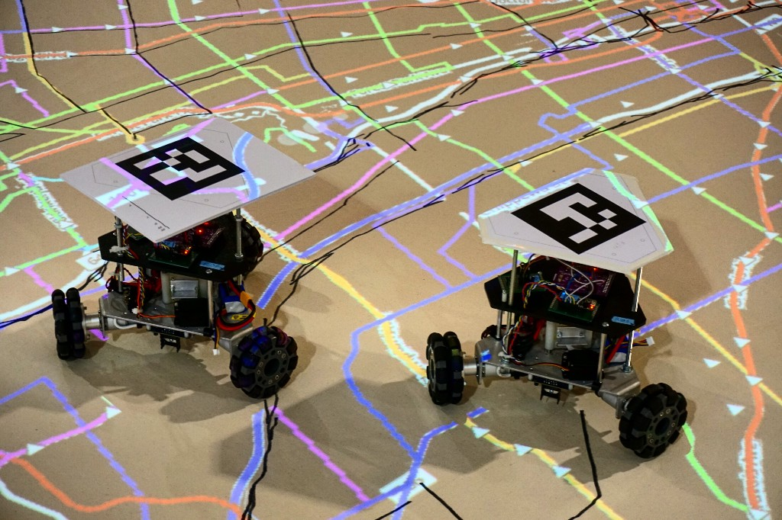

Localization and Visual Navigation of a Scalable Robot Swarm using ArUco Markers
By
Name Roll No. Registration No.
Swarnendu Sardar 11700116026 161170110087 of 2016-2017
Sounak Mondal 11700116035 161170110078 of 2016-2017
Soumik Dhar 11700116039 161170110074 of 2016-2017
Arindam Samanta 11700116098 161170110015 of 2016-2017
in partial fulfillment of the requirements for the degree of Bachelor of Technology in
COMPUTER SCIENCE & ENGINEERING
Under the supervision of
Dr. Pramit Ghosh
Department of Computer Science & Engineering
RCC INSTITUTE OF INFORMATION TECHNOLOGY
Affiliated to Maulana Abul Kalam Azad University of Technology,
WestBengal, Canal South Road, Beliaghata, Kolkata – 700015

Slide 2
Introduction
Robot localization is the process of determining where a mobile robot is located with respect to its environment. In a typical robot localization scenario, a map of the environment is available and the robot is equipped with sensors that observe the environment as well as monitor its own motion.
Robot navigation means the robot's ability to determine its own position in its frame of reference and then to plan a path towards some goal location. Some robot navigation systems use simultaneous localization and mapping (SLAM) to generate 3D reconstructions of their surroundings. Navigation can be defined as the combination of the three fundamental competences:
Self-localisation
Path planning
Map-building and map interpretation
ArUco markers are special augmented reality markers which have a unique identification number inside them. Each marker is a NxN grid (N can be 3,4,5 etc.) that is black and white in color. ArUco markers are based on Hamming code. In the grid, the first, third and fifth columns represent parity bits. The second and fourth columns represent the data bits. Hence, there are ten total data bits. So the maximum number of markers that can be encoded are - 2^10 = 1024

Slide 3
Literature Review
Navigation is one of the most challenging competencies required of a mobile robot. Success in navigation requires success at the four different stages:
1. Perception- the robot must interpret its sensors to extract meaningful data
2. Localization- the robot must determine its position in the environment
3. Cognition- the robot must decide how to act to achieve its goals
4. Motion control- the robot must modulate its motor outputs to achieve the desired trajectory
For most use cases GPS is used for localization and navigation, which is based on the concept of triangulation to give the current location of any object in 3D space. But sadly, it cannot be used in a small or compact environment, like, for indoor navigation. For this alternatively we have IR sensors, LiDAR sensors, Camera sensors, etc. which can be used to sense the environment and make informed decision.
These sensors help in determining the position of the bot relative to some reference point in the environment. At every passing moment these sensors are passing data which when compared to the current environment, gives the relative position of the bot.

Slide 4
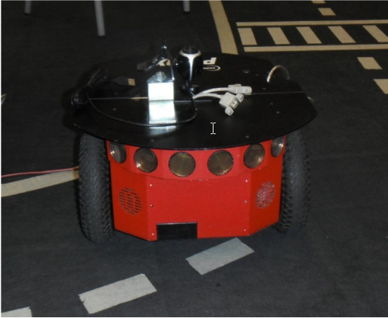
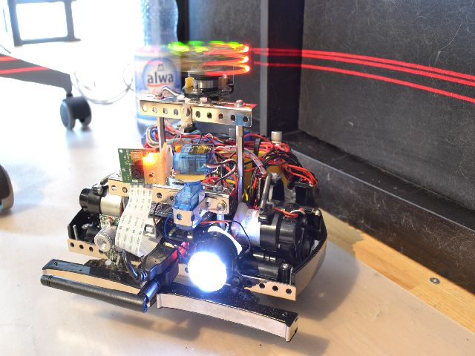
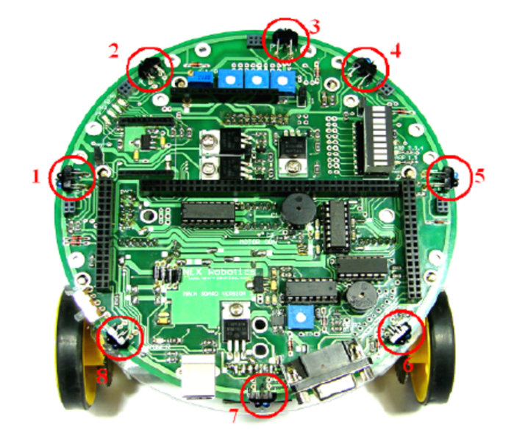
To build a system like this we would need a lot of these sensors and actuators that sense and manipulate the environment and change the bot’s position. But there are limitations:
1. These sensors and actuators are actually very error prone.
2. Stacking up so many sensors on a single bot makes the whole process of localization and navigation very complex and setup becomes too expensive.
Camera mounted bot
LiDAR sensor based bot
IR sensor based bot
Each of these systems requires lot of hardware components that are very expensive and the overall design becomes very complex.

Slide 5
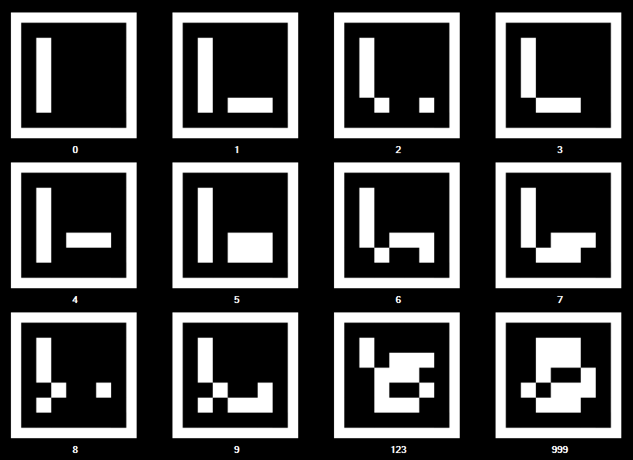
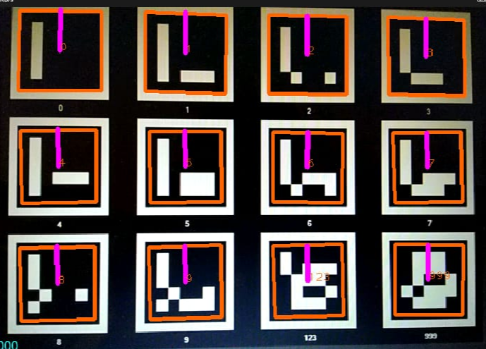
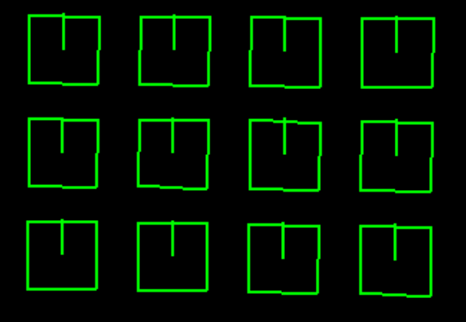
So to achieve the same objective with the least possible efforts and at 1/10 the cost we can use ArUco markers for object detection and localization. ArUco marker is basically a 2D N*N matrix (N=4, 5, 6, …) of black and white square blocks. These ArUco markers can be easily detected by using any camera module. Everything required to do the ArUco marker detection is already available in the ArUco library. Advantages of this library is that it is fast, making it a good choice for video capturing, and the binary square markers are easily detectable. The final problem of localization and navigation is taken care of by implementing certain mathematical functions to find out the position of the bot in 3D space and convert it into 2D (x, y) coordinates.
ArUco Markers
Detected ArUco Markers
Simulated ArUco Markers

Slide 6
Problem Definition
In this project we are attempting to achieve localization and waypoint navigation of bot using ArUco Markers to facilitate autonomous path traversal.
The problem can be classified into four categories:
Localization: Finding the current position of the bot in the picture frame i.e. finding the x & y coordinates of the bot.
Navigation: To navigate or move the bot from one location to another, where it tries to close in on the target waypoint.
Simulation: Simulate or relay the actions of the bot on a monitor screen.
Communication: Setup an appropriate communication channel between the bot and our pc for relaying instructions to the bot to follow a predefined path.

Slide 7
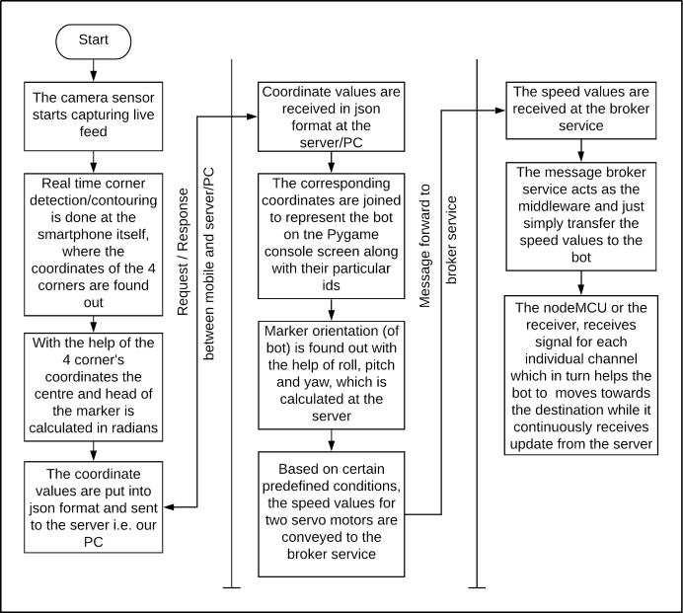
Work-Flow Diagram
Project Work-Flow

Slide 8
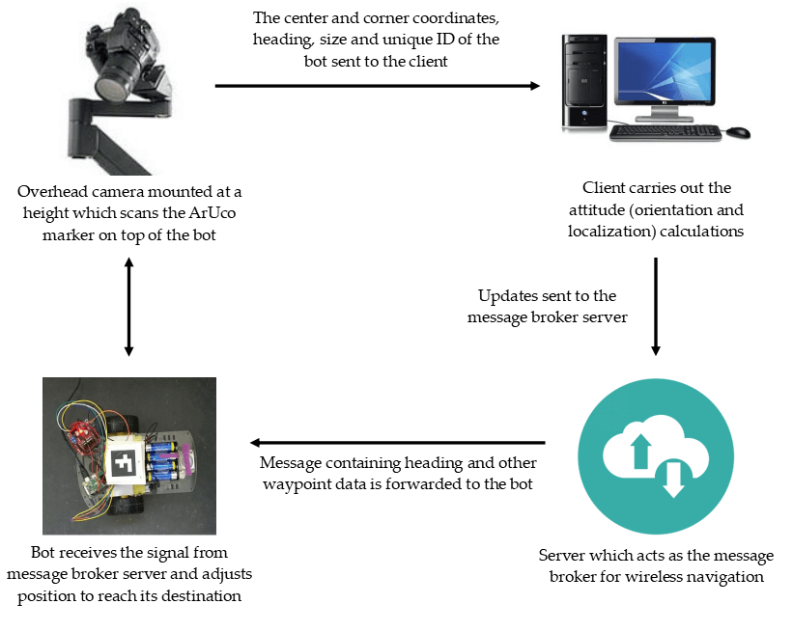
System Architecture

Slide 9
Methodology
In this project we’ve tried to address the issue of indoor navigation using image processing which is implemented with the help of the OpenCV python module.
OpenCV helps in successfully detecting the aruco markers and identifying the centre coordinates along with the corner values. The heading of the robot (in this case the virtual pseudo North direction) is shown using a different color.
The x and y coordinates are mathematically computed by keeping the top-left corner as the point of reference. The centre of the aruco marker is calculated at the video source i.e. the smartphone and the data is relayed to the server which then calculates the distance between the x and y coordinates of aruco marker and x and y coordinates of the target.
The main objective here is to make both the coordinates same i.e. the coordinates of aruco marker should overlap with that of the target. In this way we can make the bot traverse a predefined path autonomously without any human intervention.

Slide 10
Implementation
The implementation of the ArUco-Nav project is done in the following stages -
Generation of ArUco markers
Camera calibration
Detection of ArUco markers -
using webcam
using IP webcam (Android application)
using Aruco Server (Android application) [chosen method for this project]
Simulating robot localization based on marker heading and orientation obtained by processing the video feed.
Implement waypoint navigation between multiple targets by communicating with the robots using MQTT/TCP or other suitable protocols.

Slide 11

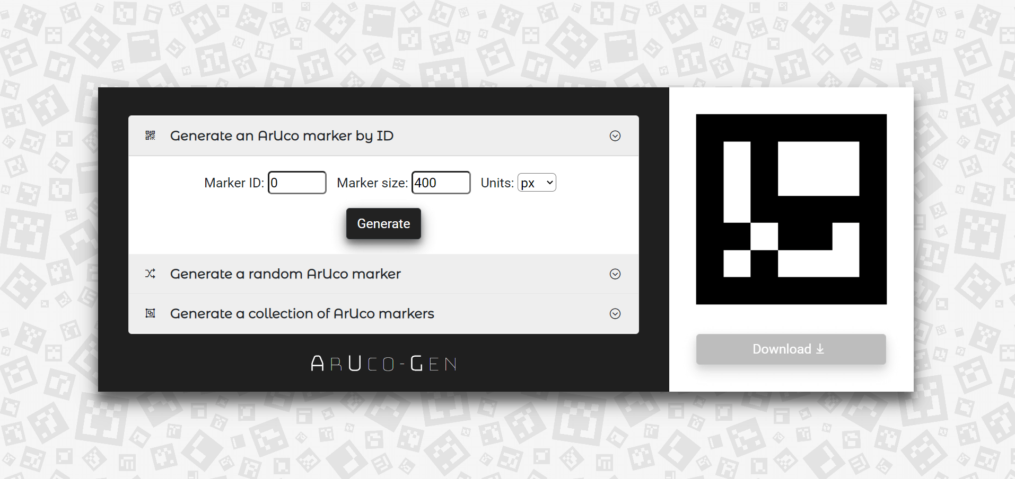
Implementation (contd...)
1. Generation of ArUco markers:

Slide 12
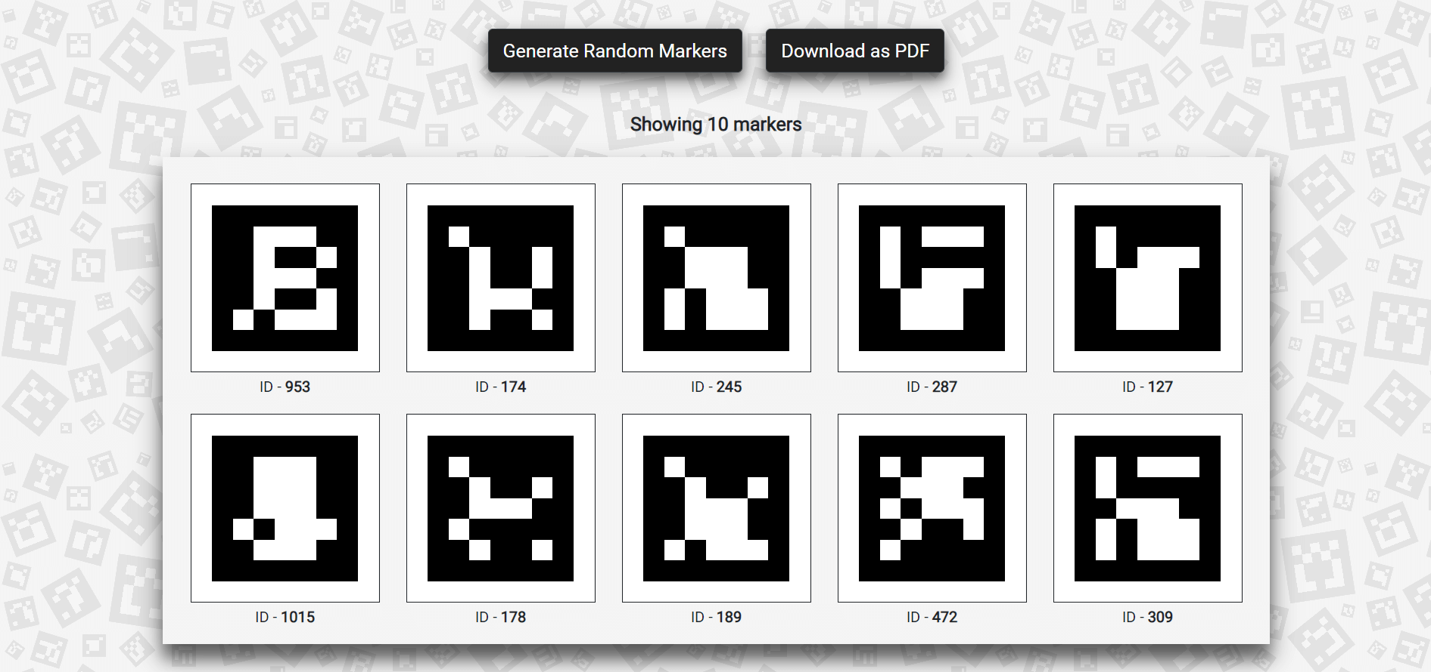
Implementation (contd...)
Generated ArUco tags:

Slide 13
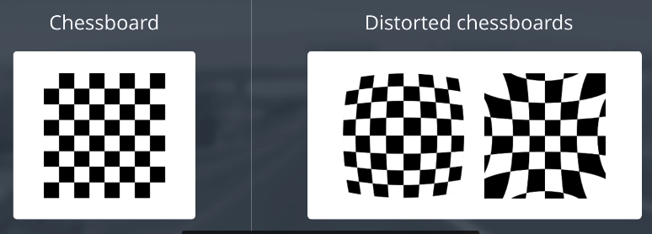
Implementation (contd...)
2.1. Camera calibration:
Barrel and Pincushion distortion in a standard chessboard

Slide 14
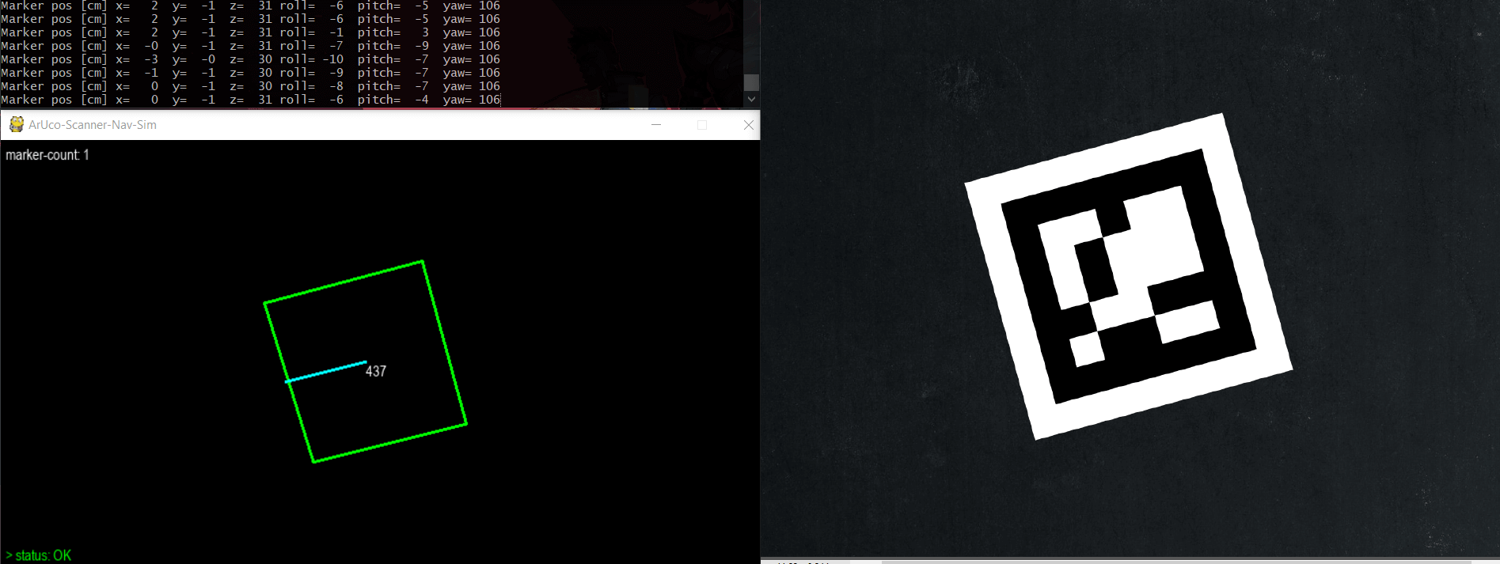
Implementation (contd...)
2.2. Pose estimation:

Slide 15
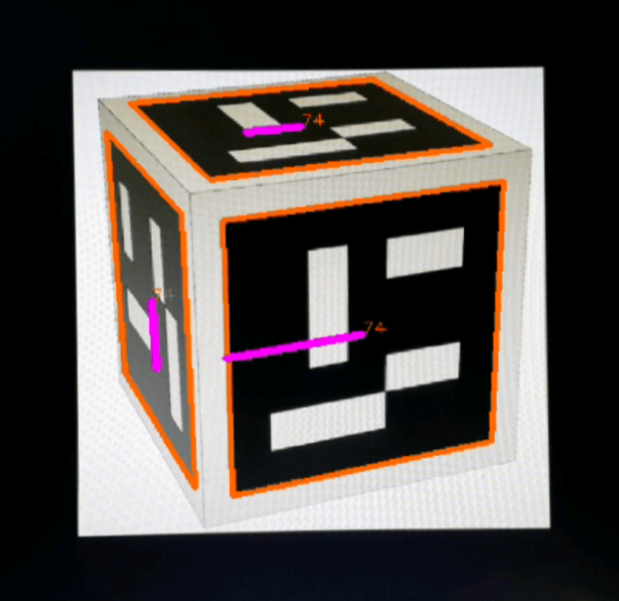
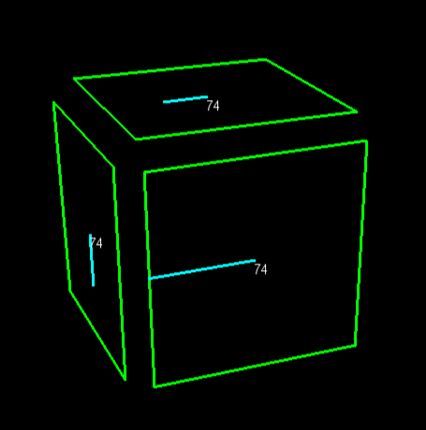
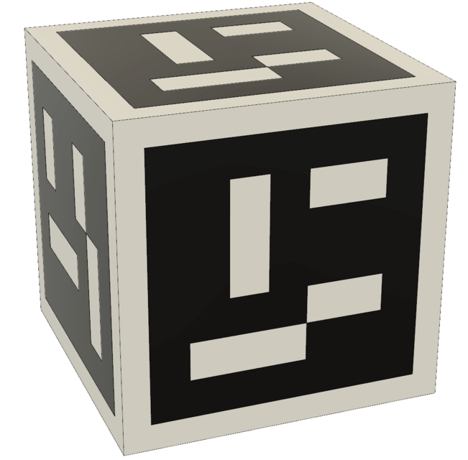
Implementation (contd...)
2.3. Compution of marker attitude:

Slide 16
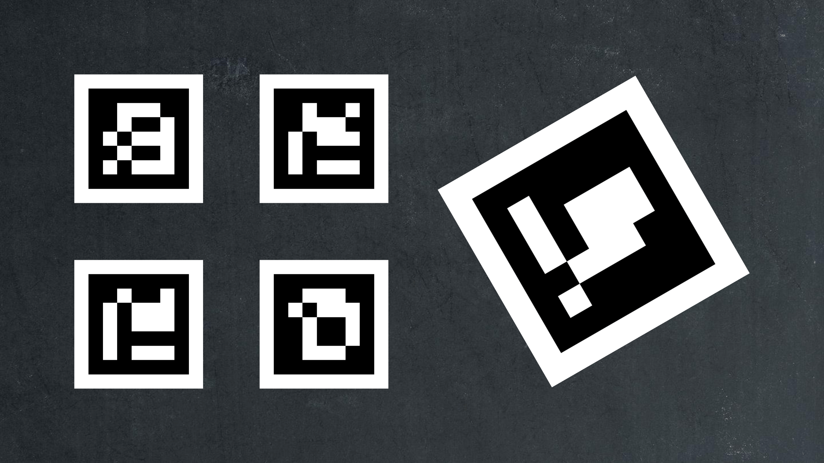
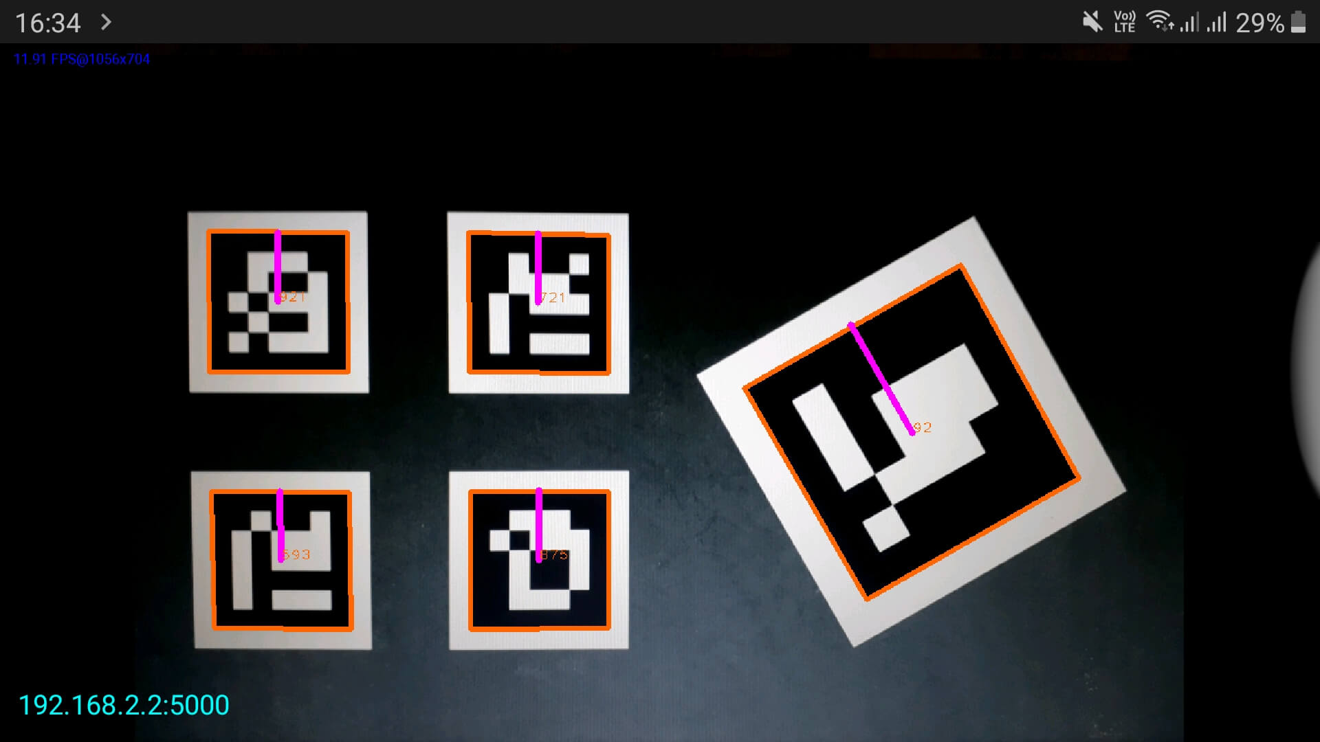
Implementation (contd...)
3. Detection of ArUco markers:
Five random ArUco markers detected using the ArUco Scanner app. The markers are bounded with an orange box with the heading indicated with a purple line. The IDs are marked at the center. The server runs at 192.168.2.2:5000 and sends a JSON response to the client containing the marker ID, center and corner coordinates, heading (in radians) and size.

Slide 17
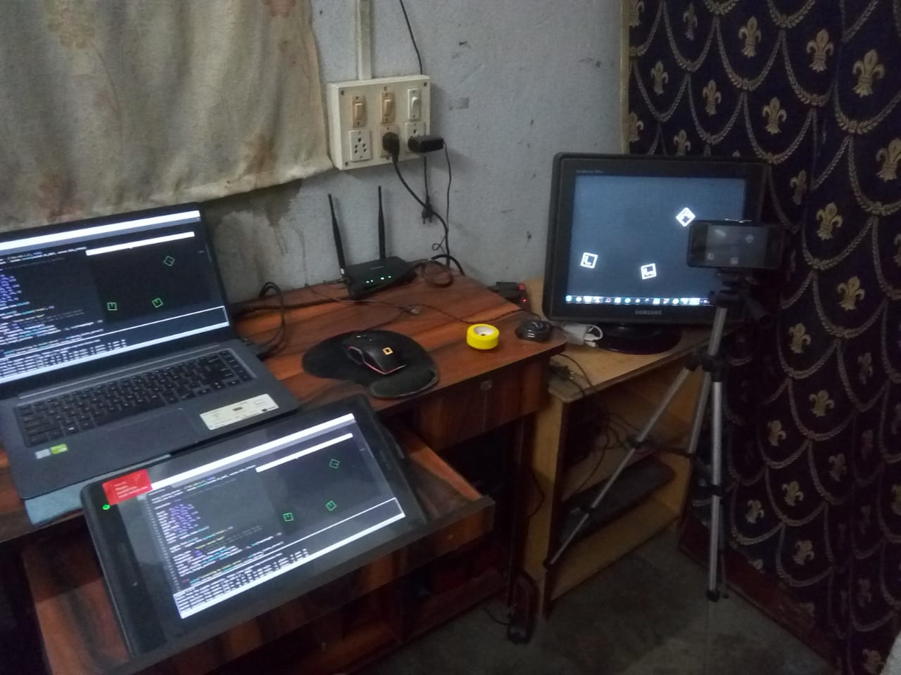
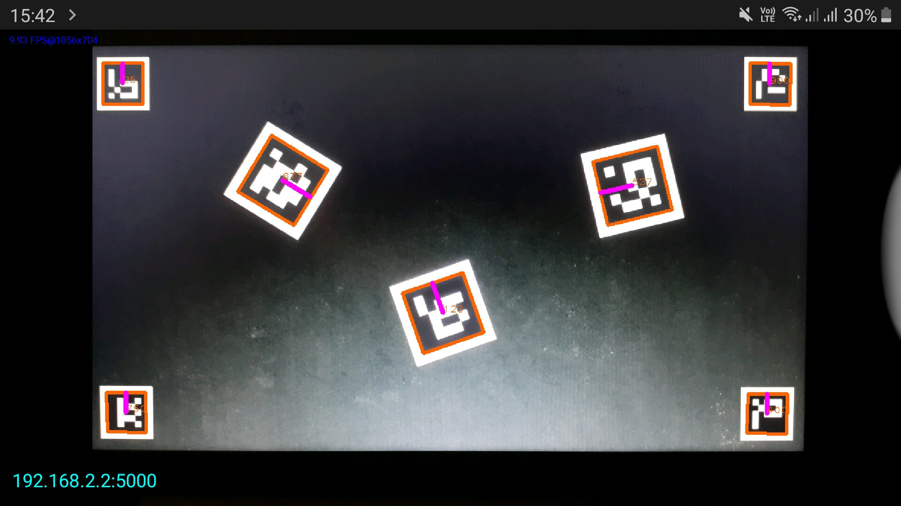
Implementation (contd...)
ArUco Scanner App based marker detection and localization:

Slide 18
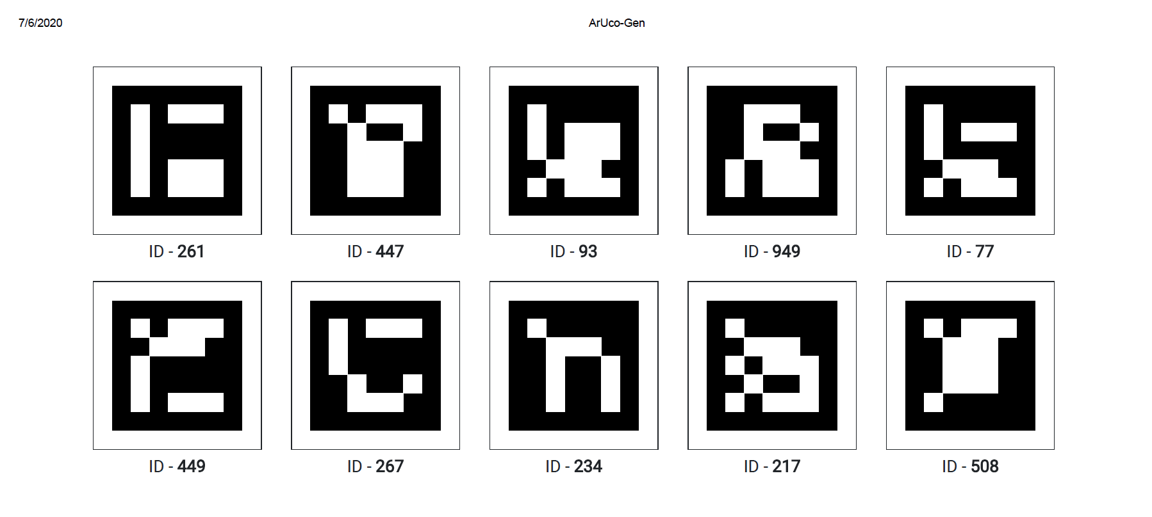
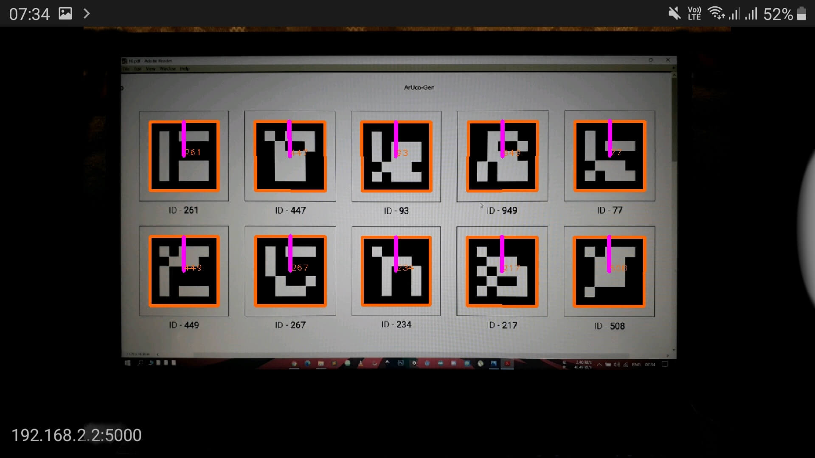
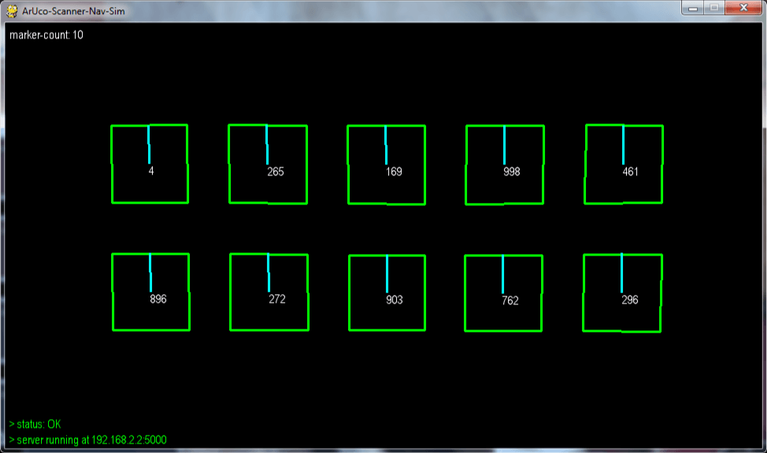
Implementation (contd...)
4. Localization of ArUco markers:
The algorithm of the localization program (aruco_nav_sim.py) is as follows:
Step 1: Start
Step 2: Import required modules and create a socket instance
Step 3: Initialize pygame with a window size of 1280x720
Step 4: Establish connection to vision server at 192.168.2.2:5000
Step 5: If window is not closed, goto Step 6, else goto Step 15
Step 6: Send a request to the server with the character “g” encoded
Step 7: Load the JSON response for all markers in a new list
Step 8: For every marker in the list, do Step 9 to Step 14
Step 9: Extract the marker ID, size, heading, corner and center coordinates
Step 10: Call getMarkerOrientation() method to get marker attitude
Step 11: Display the values of xm, ym, zm coordinates and roll, pitch and yaw
Step 12: Draw bounding box on each marker using the corner coordinates
Step 13: Draw the heading using the center coordinates
Step 14: Update the screen
Step 15: Exit

Slide 19
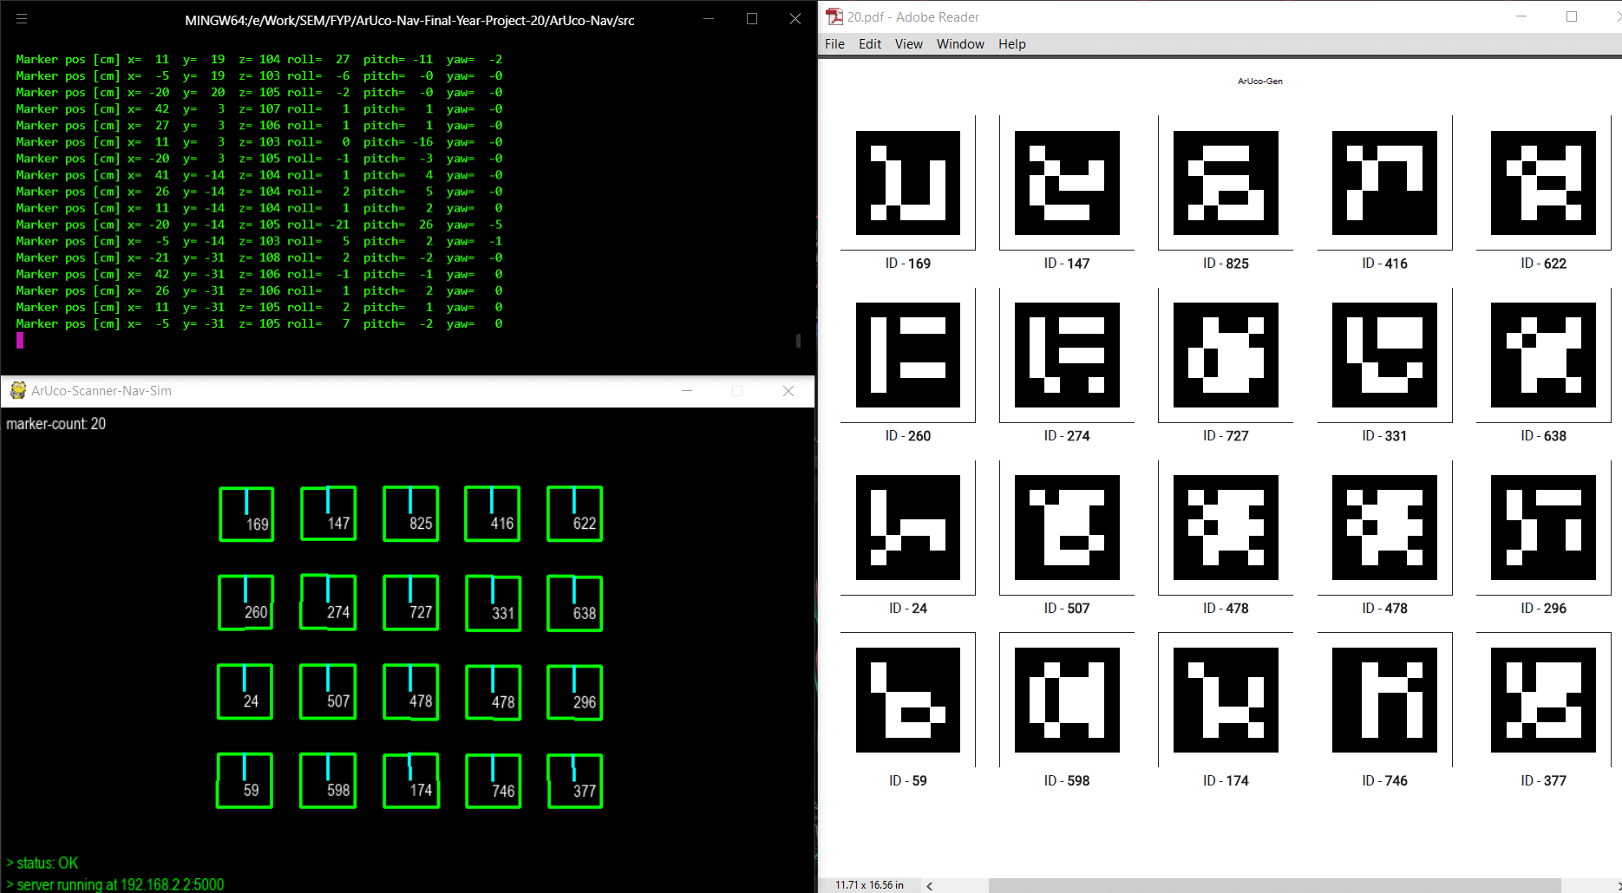
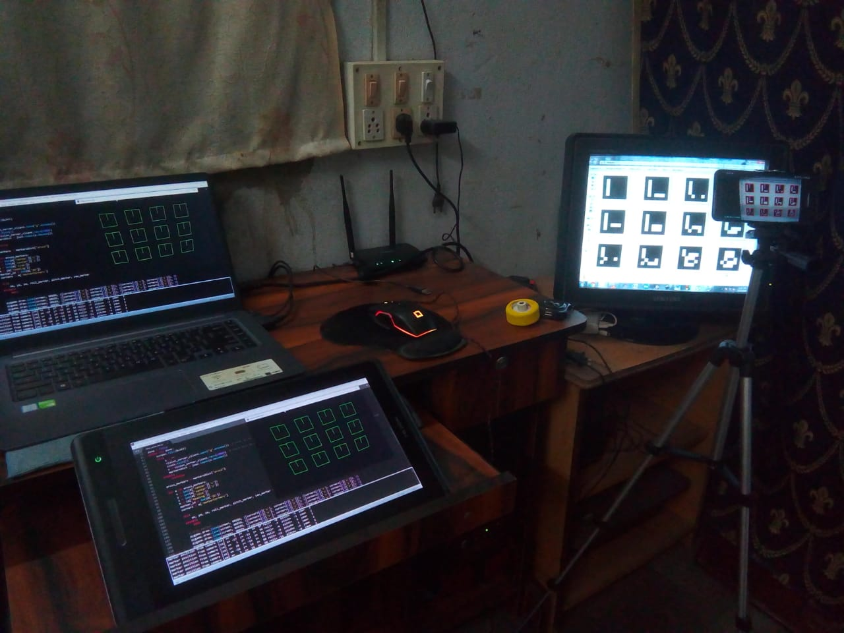
Implementation (contd...)
Simulation of robot (marker) localization:
A consolidated representation of the localization process - (from the right clockwise), a set of 20 ArUco markers, the marker orientation (attitude) data being printed on the terminal, the pygame window showing the positions of all 20 markers

Slide 20
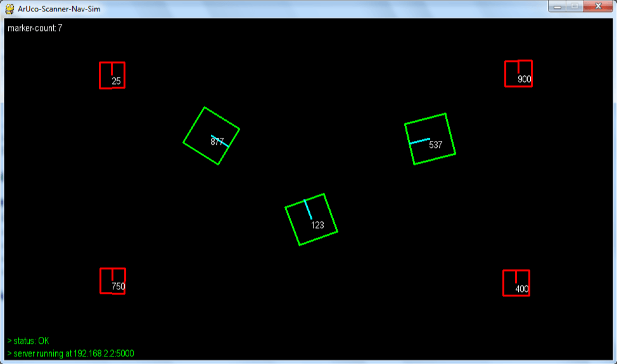
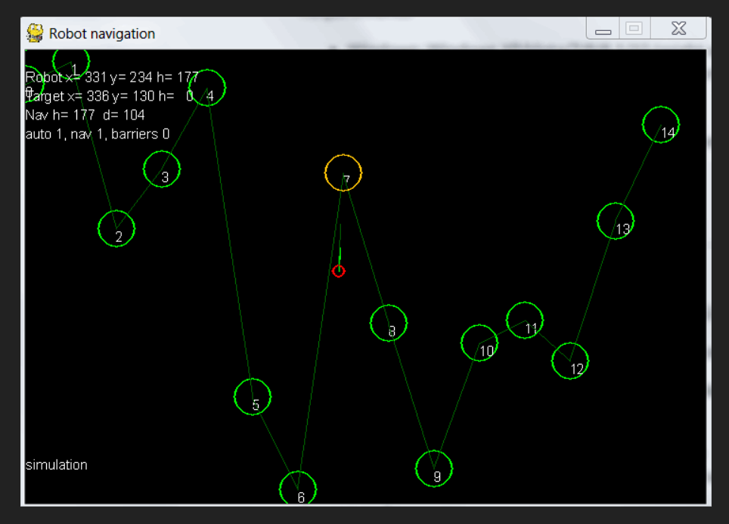
Implementation (contd...)
5. Visual navigation (simulation) using ArUco tags:
A test simulation showing three ArUco markers (and by extension, three swarm robots)(marked with green bounding boxes), two barrier objects (marked with red bounding boxes)

Slide 21
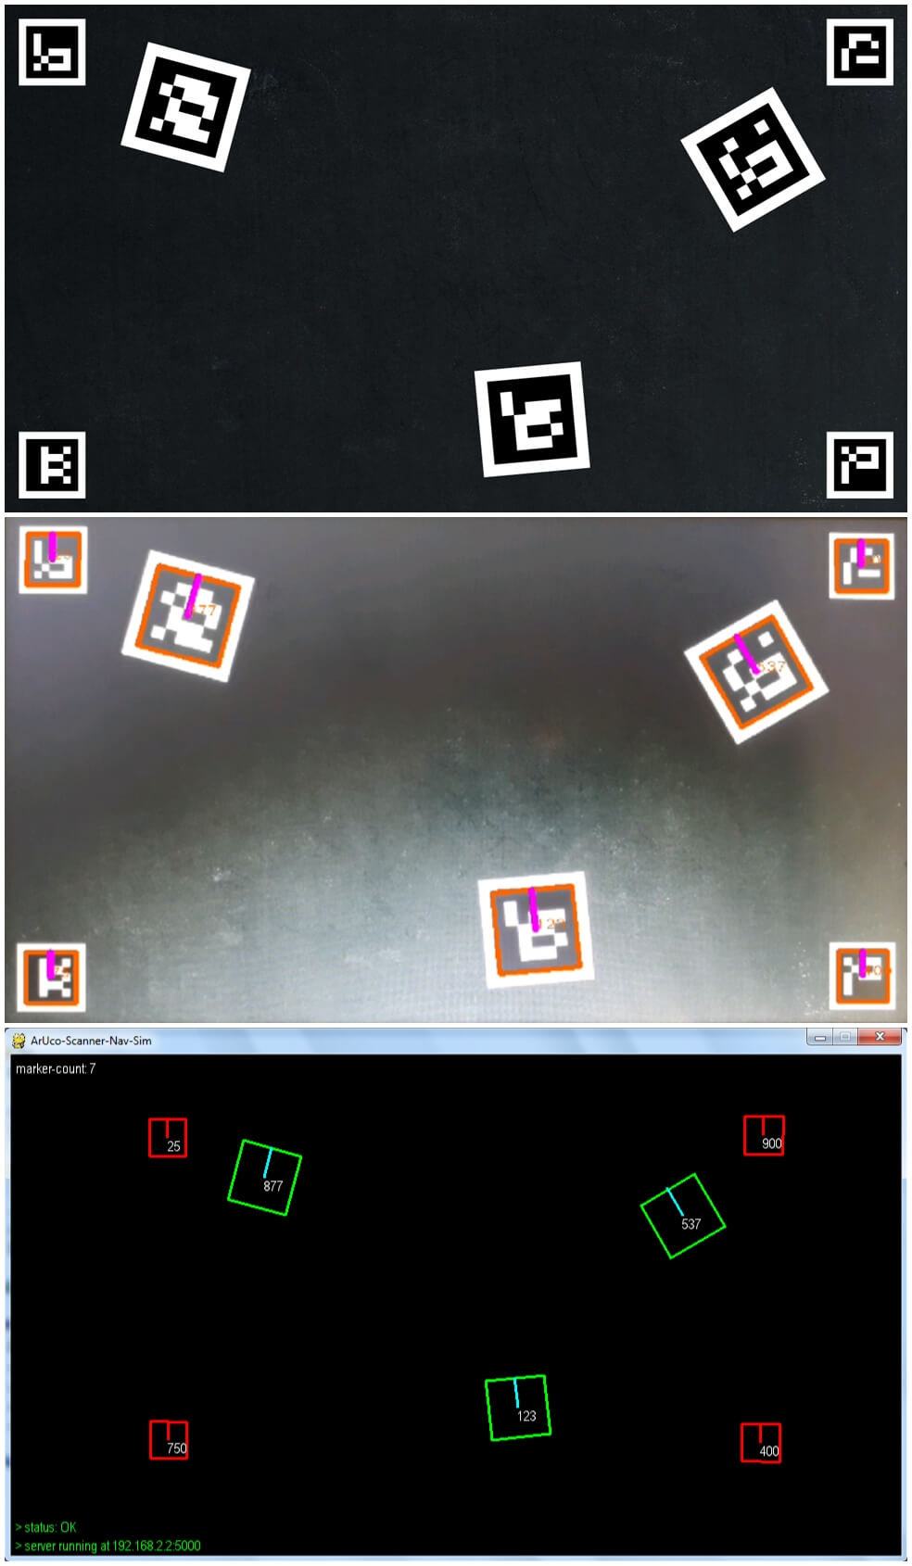
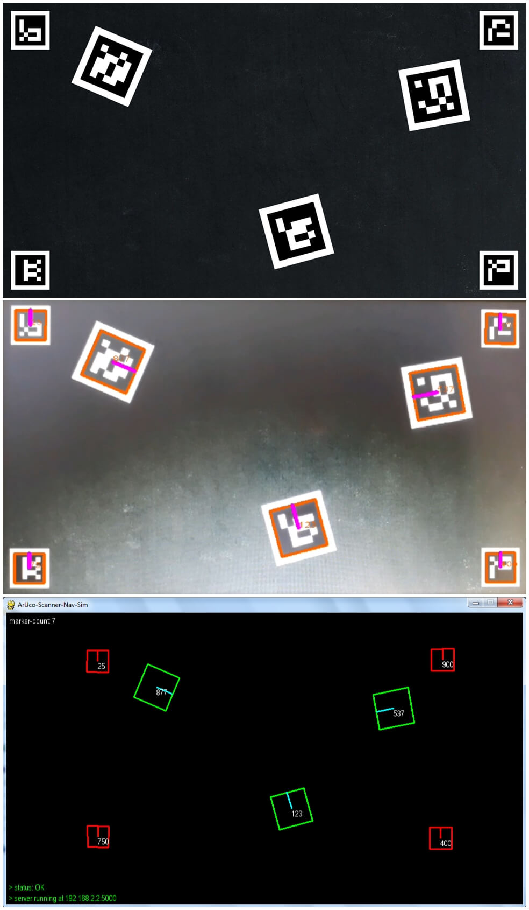
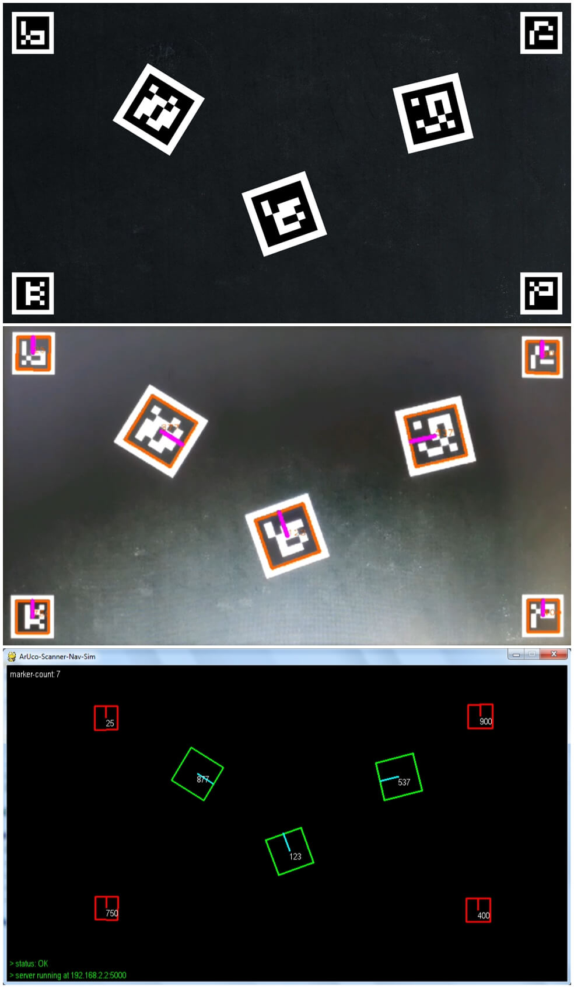
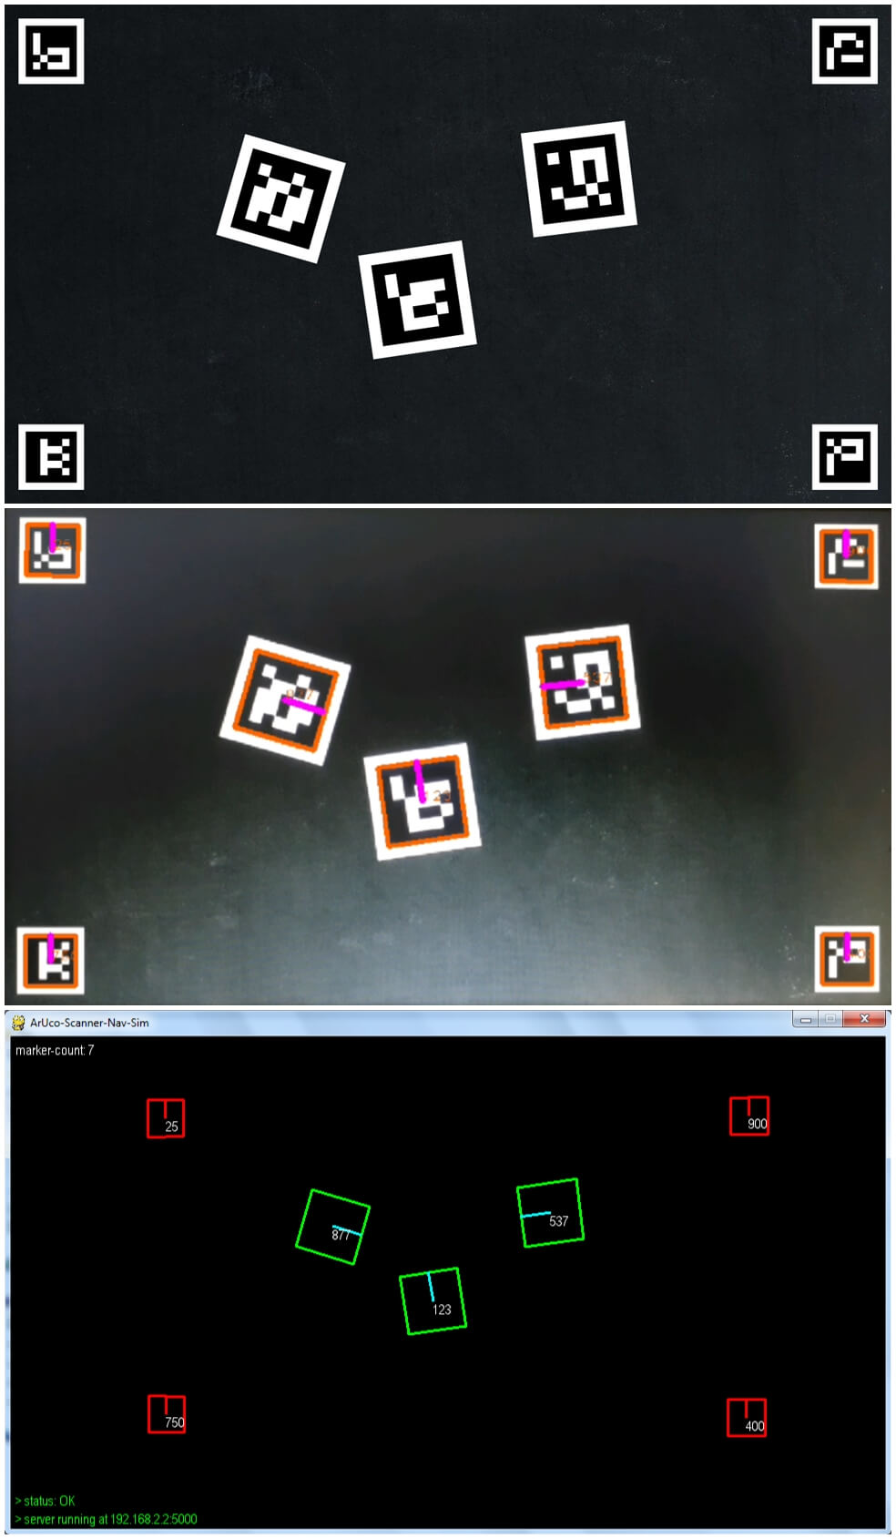
Output
time-stamp: 00:01:25; frame no.: 5
time-stamp: 00:06:25; frame no.: 25
time-stamp: 00:11:25; frame no.: 45
time-stamp: 00:13:75; frame no.: 55

Slide 22
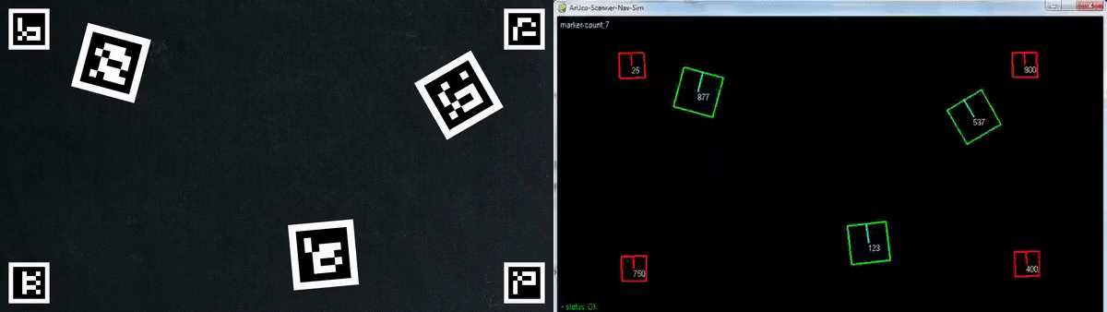
Result Analysis

Slide 23
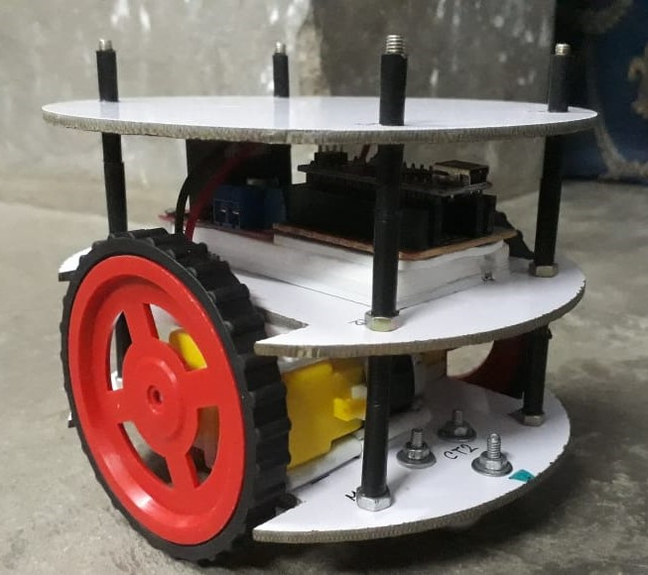
Future Work
Interface an actual robot capable of communicating with the localization and navigation components using MQTT/TCP/HTTP or other suitable protocols.
This eventually can be extended to a swarm of robots with common waypoints but autonomous (vision-guided) navigation in a controlled environment.

Slide 24
Conclusion
Localization of mobile robots in 2D space is indeed a challenging task but with more emerging technologies like ArUco and other fiducial markers, vision based detection and pose estimation is now achievable at a large scale.
Through our project ArUco-Nav, we have successfully achieved an accurate simulation of robot (or a robot cluster) detection using ArUco tags and localization of their coordinates in 2D space through the use of overhead cameras and image processing using the OpenCV python library.

Slide 25

THANK YOU
FOR WATCHING!

